Slide 1
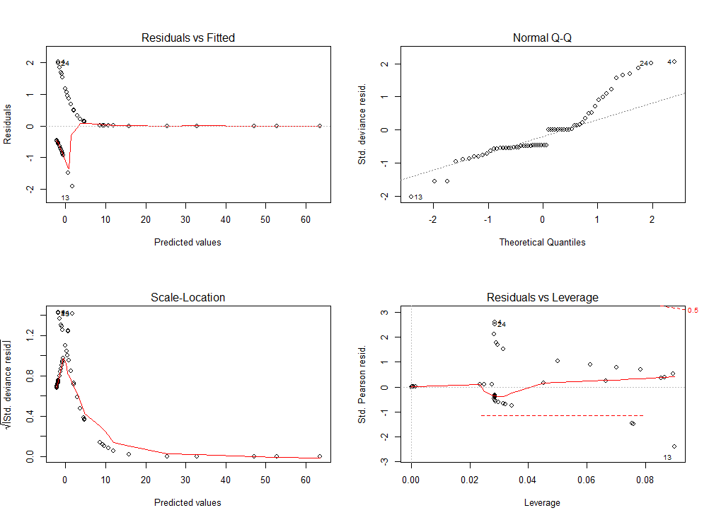
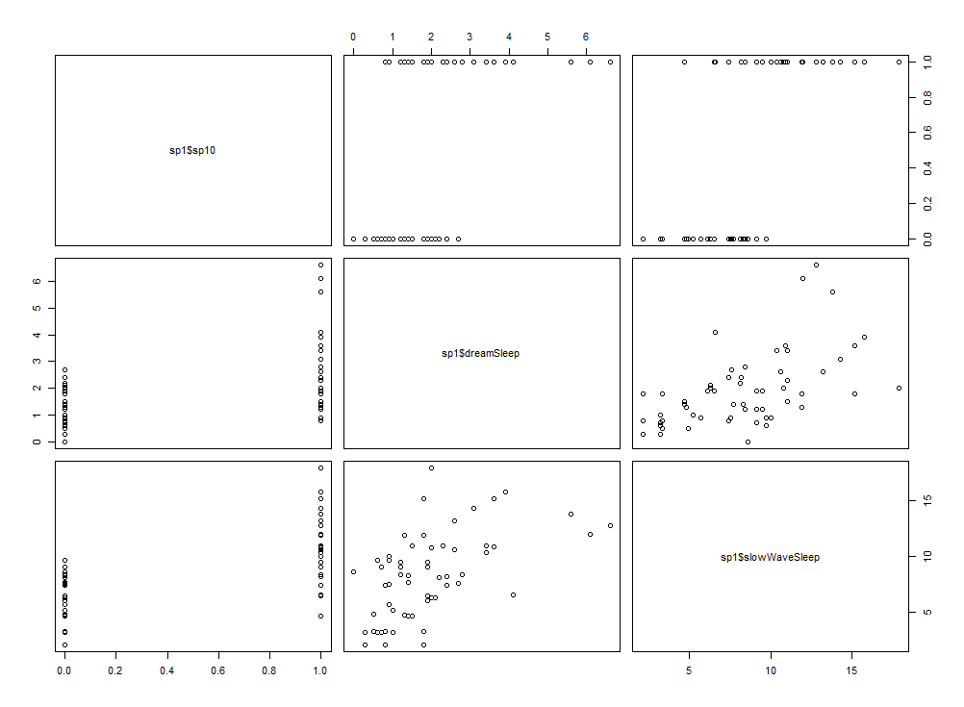
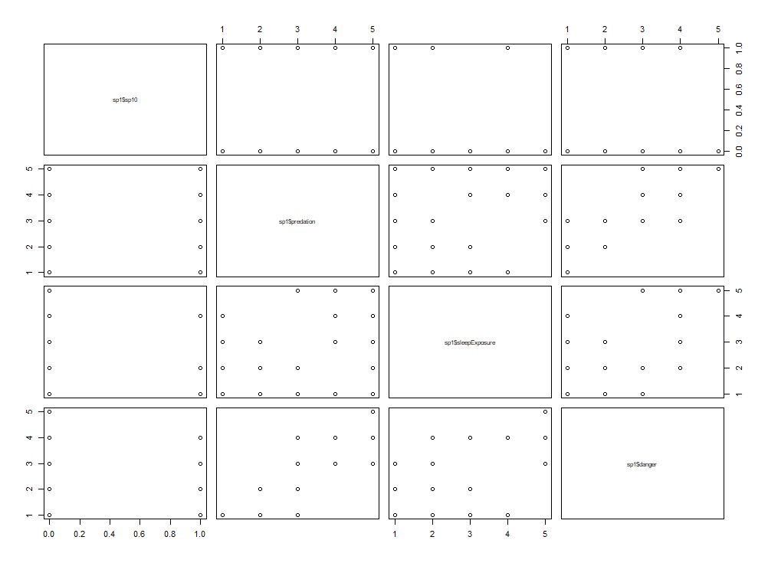
MATH4432 Mini-Project 1 : Regression: Animal Species Sleeping Hours Chow Wing Ho(20279607)
0.3886898
0.3886898
This project is going to explore what may affect the sleep that animal needs which using the multiple regression to find out the result. Also, this project use cross-validation and bootstrap to the estimation of test error.
Methods
Test the multilinear regression
The diagram of best regression (M10)
Missing values
- using the packages “Mice” ,max. iteration and CART decision tree to fill in missing value which this method use the missing value be Y and other values be X to predict the value Y.
Dependent Variable
Use dummy variable (sp10) to express the dependent variable which the value of sleep larger than median value of sleep
Independent Variables
Use the multiple regression of all factors to decide the predictors with p-values for the dependent variable.
equation:
m9 = lm(sp10 ~ slowWaveSleep + dreamSleep + brain + body + life + gestation + predation + danger + sleepExposure)
Summary of m9 regression show that the slowWaveSleep and dreamSleep are significant to Dependent Variable and the variables (danger, predation and sleepExposure) are likely having relationship to the Dependent Variable.
Use slowWaveSleep, dreamSleep , predation ,danger and sleepExposure for different various multilinear regression (M1 – M10)
M1 = glm( sp10 ~ dreamSleep + slowWaveSleep + predation + danger + sleepExposure)
M2 = glm( sp10 ~ slowWaveSleep + danger+ predation + dreamSleep + sleepExposure^2)
M3 = glm( sp10 ~ slowWaveSleep + danger^2+ predation + dreamSleep + sleepExposure)
M4 = glm( sp10 ~ slowWaveSleep + danger + predation^2+ dreamSleep)
M5 = glm( sp10 ~ slowWaveSleep + dreamSleep +danger^2 * predation^2 )
M6 = glm( sp10 ~ slowWaveSleep^2 + dreamSleep + danger + predation)
M7 = glm( sp10 ~ slowWaveSleep + dreamSleep^2 + danger + predation)
M8 = glm( sp10 ~ slowwavesleep^2 * dreamSleep^2 + danger + predation)
M9 = glm( sp10 ~slowWaveSleep +dreamSleep)
M10= glm( sp10 ~ slowwavesleep^2 * dreamSleep^2)
Sp10 vs slowWaveSleep and dreamSleep
Add title if necessary. Click the B button on the home tab to add bold formatting.
Background item
Background item
Background item
Results of M1 –M10
Cross-validation and bootstrap
After testing the different multilinear regression, use the “boot” packages with cv.glm () to compare the MSE with ten regression
- cv.glm (sp1,Mi )$Delta # “i” is integer 1 - 10
The result finds that the Mean Squared Error of the tenth multilinear regression is the lowest ( 0.3886898)
Use bootstrap method to test error of model (M10)
The result of bootstrap that standard deviation of M10 is quite low which is 0.003579715
Sp10 vs danger , predation and sleep Exposure
Conclusion
List objectives here
Objective 1
Objective 2
Objective 3
In conclusion:
1) the simple multilinear regression of nine variables can show some variables are useless in affecting sleep of animals (e.g.. Brain, Body…) as the coefficient of these useless variables are extremely small.
2) from the result of ten regression, we can see that the p-values of variables relate to slowWaveSleep and dreamSleep are mostly very small and significant in P<0.01, that means these two variables are key factor to affect the sleep of animals
4) the standard deviation of regression M10 by using bootstrap is very small that means fill in the missing value of NAs are appropriate.
The table show that variable related to danger, predation and sleep exposure are not significant which p-value larger than 0.01,0.05,0.1.

